Slide 1
Data Oriented Programming in Java
Rémi Forax
Université Gustave Eiffel – Sept 2022

Slide 2

Don’t believe what I’m saying !

Slide 3
I’m a huge proponent of designing your code around the data, rather than the other way around […]
Bad programmers worry about the code. Good programmers worry about data structures and their relationships.
-- Linus Torvalds

Slide 4
Did Linus just disrespect OOP ?

Slide 5
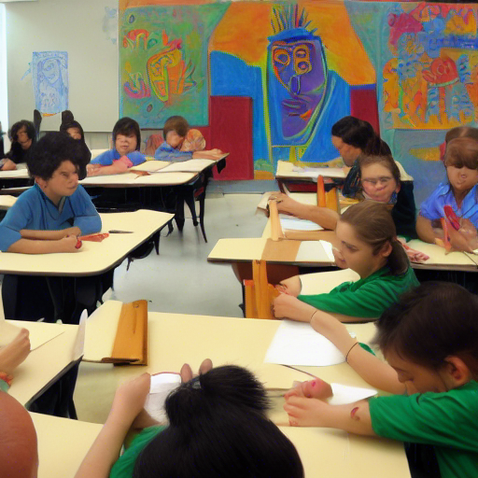
Structure definitions in Java
(let’s go back to school)
class-room-as-picasso

Slide 6
Structure definitions (Java 1.0)
A class mixed
  Data definition (mutable fields)
  Behaviors (methods)
class Drawing {
private String title;
public Drawing(String title) { this.title = title; }
public int price() { return title.length * 100; }
}

Slide 7
Structure definitions (Java 8)
A lambda is an anonymous function
  data ?
  one function
interface Article {
int price();
}
…
public static Article drawing(String title) { return () - > title.length * 100; }

Slide 8
Structure definitions in Java 8+
class (mutable data + methods)
lambda (immutable data + one function)

Slide 9
Structure definitions (Java 17)
A record is pure data ?
  immutable data
  methods ?
record Drawing(String title) {}
…
public static int price(Drawing drawing) {
return drawing.title() * 100;
}

Slide 10
Structure definitions (Java 17+)
class (mutable data + methods)
lambda (immutable data + one function)
record (immutable data + no* methods)
* you can if you want but that not the main style

Slide 11
Structure definitions (Java 17+)
lambda
---
immutable data + 1 function
record
---
immutable data + no method
behavior
data
class
---
mutable data + methods

Slide 12
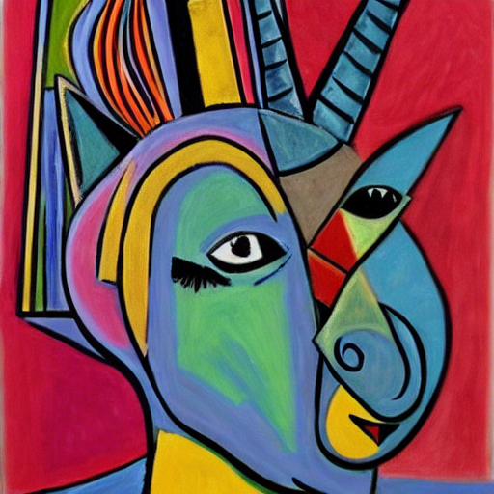
What is a record and
where to use them ?
fantastic-unicorn-as-picasso

Slide 13
DEMO !
(1 / 3)

Slide 14
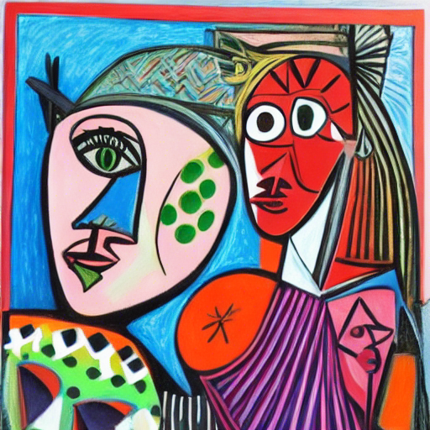
Pattern Matching
matching-as-picasso

Slide 15
Virtual Polymorphism
interface Article {
int price();
}
record Drawing(String title) implements Article {
public int price() { return title.length() * 100}
}
enum Maker { DISNEY, ACME }
record Toy(Maker maker) implements Article {
public int price() {
return switch(maker) {
case DISNEY -> 1_000;
case ACME - > 130;
};
}
}

Slide 16
Pattern Matching
interface Article { int price(); }
record Drawing(String title) implements Article { }
enum Maker { DISNEY, ACME }
record Toy(Maker maker) implements Article { }
int price(Article article) {
return switch(article) {
case Drawing drawing - > drawing.title().length() * 100;
case Toy toy - >
switch(toy.maker()) {
case DISNEY - > 1_000;
case ACME - > 13;
};
default - > … // FIXME
};
}

Slide 17
Wadler’s Expression Problem
Polymorphism
  add new subtypes
  No new operation
Pattern Matching
  Add new operations
  No new subtypes
We can not get both :(

Slide 18
DEMO !
(2 / 3)

Slide 19
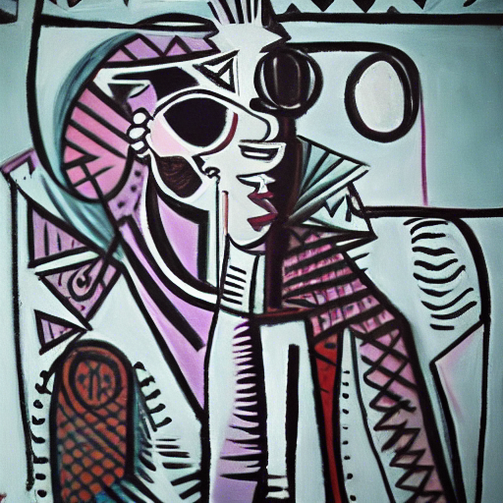
Data Oriented Programming*
dope-as-picasso
* warning overloaded term !

Slide 20
DOP Principle
Data are more important than code
When data are updated, code should follow
  Compilers should flags where updates need to be done

Slide 21
DOP in Java
Switch Expression must be exhaustive
  Add sealed types
  Switch statement get a warning
Record Pattern test the shape of a record

Slide 22
DOP in Java
sealed interface Article permits Drawing, Toy { int price(); }
record Drawing(String title) implements Article { }
enum Maker { DISNEY, ACME }
record Toy(Maker maker) implements Article { }
int price(Article article) {
return switch(article) {
case Drawing(String title) - > title.length() * 100;
case Toy(Maker maker) - >
switch(toy.maker()) {
case DISNEY - > 1_000;
case ACME - > 13;
};
// no default here !
};
}

Slide 23
We steal everything !
From Scala (2004) / Kotlin (2011)
  record come from “case class” / “data class”
  sealed keyword

Slide 24
We steal everything !
From Scala (2004) / Kotlin (2011)
  record come from “case class” / “data class”
  sealed keyword
From Standard ML (1983)
  datatype article
  = Drawing of String
  | Toy of Maker

Slide 25

Good Artists Copy, Great Artists Steal
-- Pablo Picasso
picasso-as-picasso

Slide 26
DEMO !
(3 / 3)

Slide 27
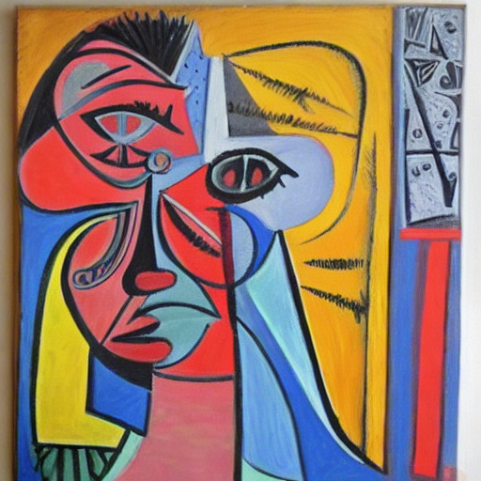
OOP vs DOP
oops-as-picasso

Slide 28
OOP vs DOP
Not on the same interfaces
  Not-sealed: users can provide new implementations
  Sealed: all implementations are known
Not at the same level
  OOP works at API level
  DOP works at implementation level

Slide 29
OOP and DOP
Not on the same interfaces
Not at the same level
  => OOP and DOP should work together

Slide 30
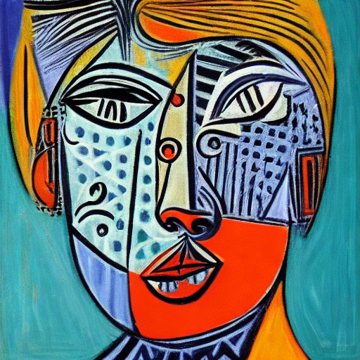
Patterns in Pattern Matching
(everything is in preview)
patterns-as-picasso

Slide 31
Type Pattern (Java 17)
Equivalent to an instanceof check
  but type safe !
  Article article = …
  switch(article) {
  case Toy toy -> …
  case Drawing drawing -> ...
  }

Slide 32
Record Pattern (Java 19)
Check the shape of a record (DOP)
  Article article = …
  switch(article) {
  case Toy(Maker maker) toy -> …
  case Drawing(String title) -> ...
  }

Slide 33
Var Pattern (Java 19)
Ask the compiler to infer the type
  Article article = …
  switch(article) {
  case Toy(var maker) -> …
  case Drawing(var title) -> ...
  }

Slide 34
Null Pattern (Java 19)
Not really a pattern
If there is a case null, switch allows null
  String s = …
  switch(s) {
  case null -> …
  case String s -> ...
  }

Slide 35
Guard Pattern (Java 19)
No really a pattern, attached to a case
Article article = …
switch(article) {
case Toy(var maker) when maker == Maker.DISNEY -> …
case Toy toy -> … // for the other makers
case Drawing d -> …
}

Slide 36
Instanceof vs switch
All patterns also works with instanceof
  record House(String… persons) {
  public boolean equals(Object o) {
  return o instanceof House(var persons) &&
  Arrays.equals(this.persons, persons);
  }
  // + hashCode
  }

Slide 37
Any Pattern ‘_’ (Java 20)
I don’t care about that value
  Point point = ...
  switch(point) {
  case Point(var x, _) - > …
  case Point(_, _) - > ...
  }
  Also works in lambda, for, catch and try-with-resources !

Slide 38
Primitive Pattern (Java 20)
Is a primitive cast is safe ?
  int value = …
  switch(value) {
  case short -> … // values in Short.MIN_VALUE … MAX_VALUE
  case int i -> ...
  }
  I don’t like it but I’m not the spec lead !

Slide 39
Array Pattern (Java 20)
Has several items (exact count)
  String[] array = …
  switch(array) {
  case String[] { var i1, var i2 } -> … // if two items
  case String[] array -> … // other arrays
  }

Slide 40
Constant Pattern (Java 21+)
Use a constant (syntax still in flux)
  Point p = …
  switch(point) {
  case Point(0, 0) -> ...
  case Point _ -> ...
  }

Slide 41
And more ...
Pattern assignment
  Point(int x, int y) = point;
Deconstruction pattern
  Record pattern but on interface class and enum
Named pattern
  switch(optional) {
  case Optional.of(var value) -> ...
  case Optional.empty() -> ...
  }

Slide 42
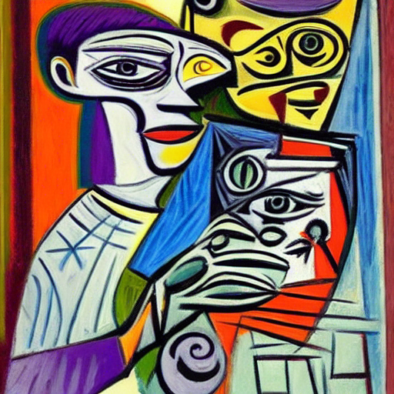
Questions ?
questions-as-picasso
All images have been dreamed by Stable Diffusion

